Slide 1
FalL Detection using floor sensor
Quan Do
Xiaowei Yu
Abul Hasan Sayeed

Slide 2
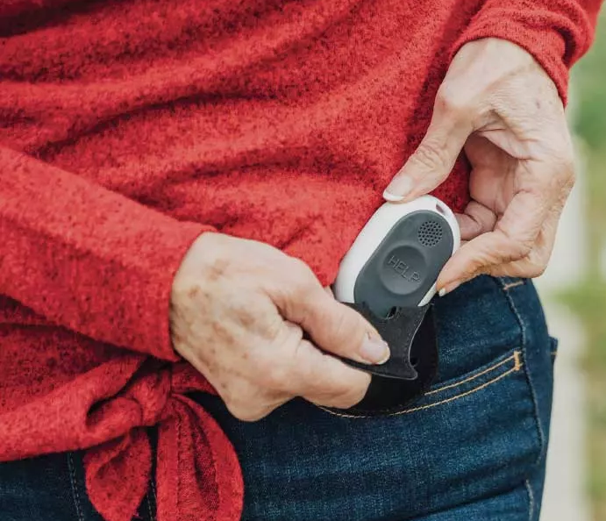
Introduction
More than 32000 deaths from 36 million falls
Existing variations of fall detection
Inconvenience of wearable device

Slide 3
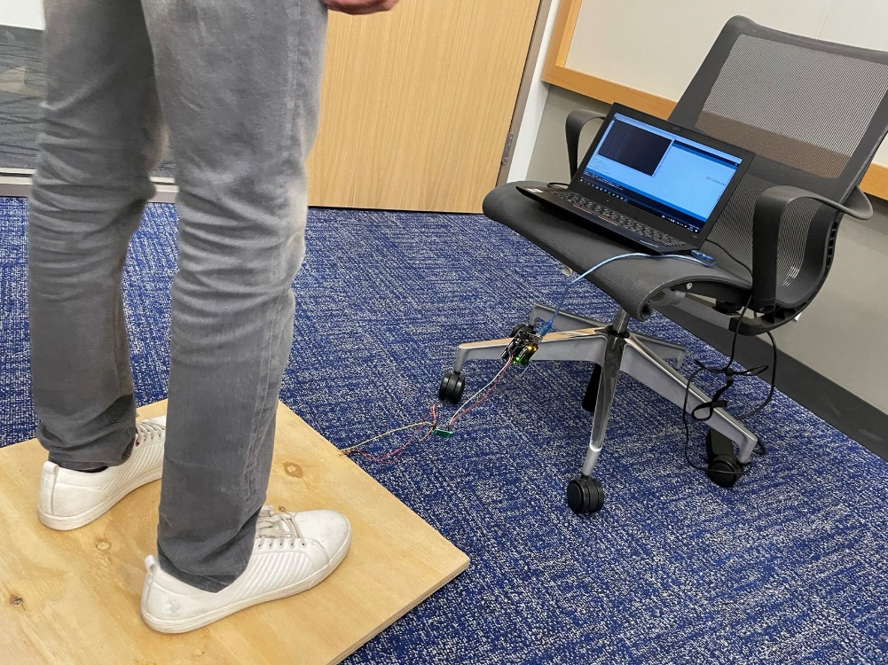
System overview (software design)
Data Flow
Predicted Results
Pressure Sensors
MCU
PC
PC
MCU
Amplifier
Pressure Sensors (beneath)

Slide 4
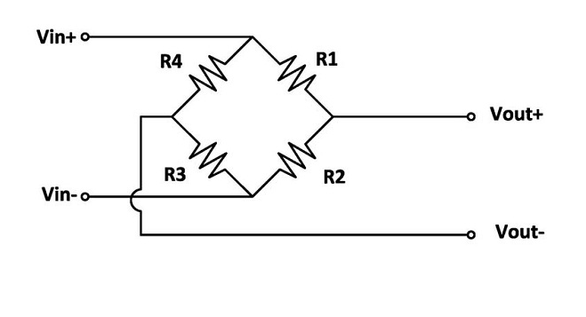
Hardware Design
•Using load cells (transducers)
•Using Wheatstone Bridge Principle
•Output signal is the voltage difference between R2 and R3
•Output signal is transmitted to MU

Slide 5




BEHAVIOR Categories
Walking
Jumping
Falling
Standing/Sit

Slide 6
System overview (software design)
Pressure Data
(Raw Data)
Data Cleaning
(Preprocessed)
Pre-trained Machine Learning Model
Platform: Arduino
Coding: Python
IDE: Visual Studio Code
System: Windows 10
Graphic User Interface: tkinter
Fall
Alert
(Play Sound)
Machine Learning Algorithms: SVM, KNN, Random Forest
Prediction Performance Improvement Strategy:
Ensemble Learning
Do Nothing

Slide 7
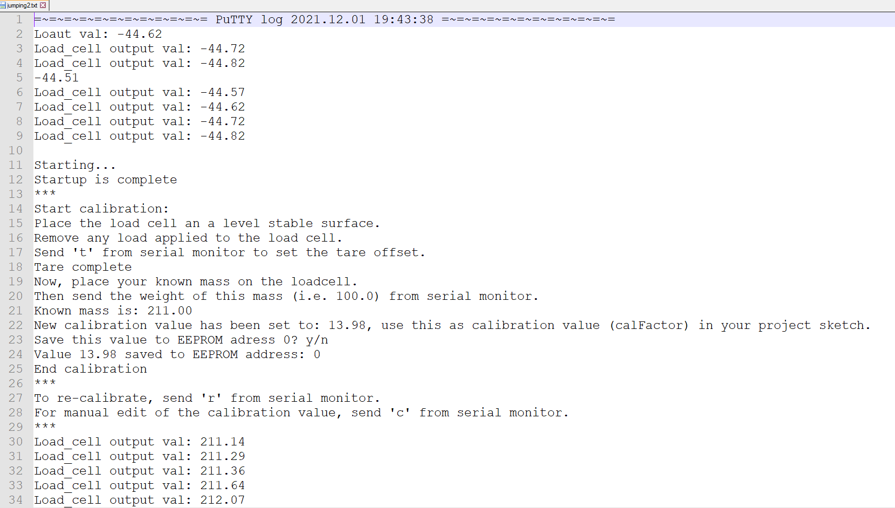
Evaluation
Raw Data from the Pressure Sensors

Slide 8
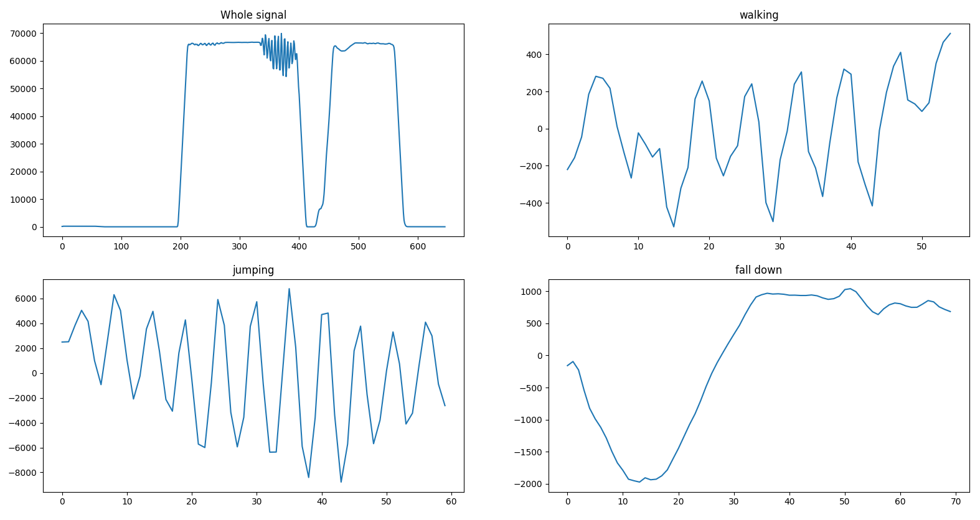
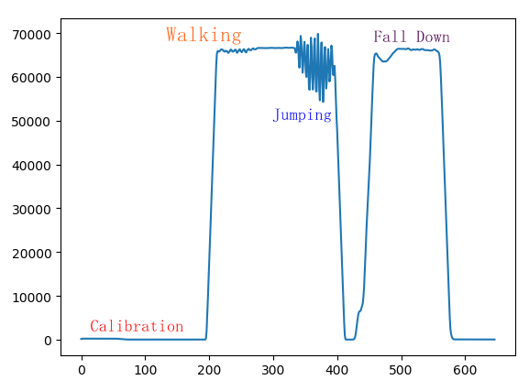
Evaluation
Visualization of Different Behavior Patterns in Time Domain

Slide 9
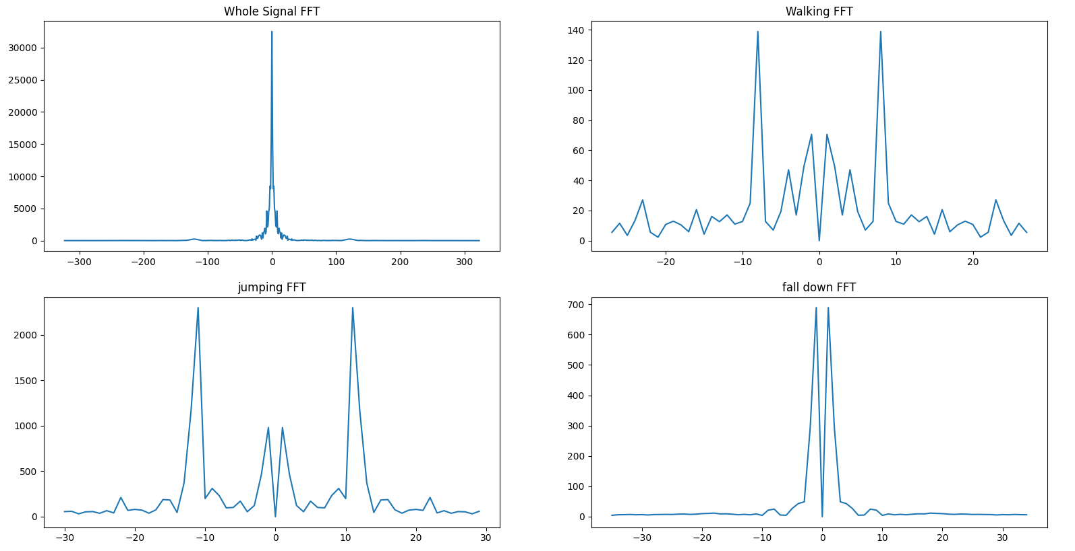
Evaluation
Visualization of Different Behavior Patterns in Frequency Domain

Slide 10
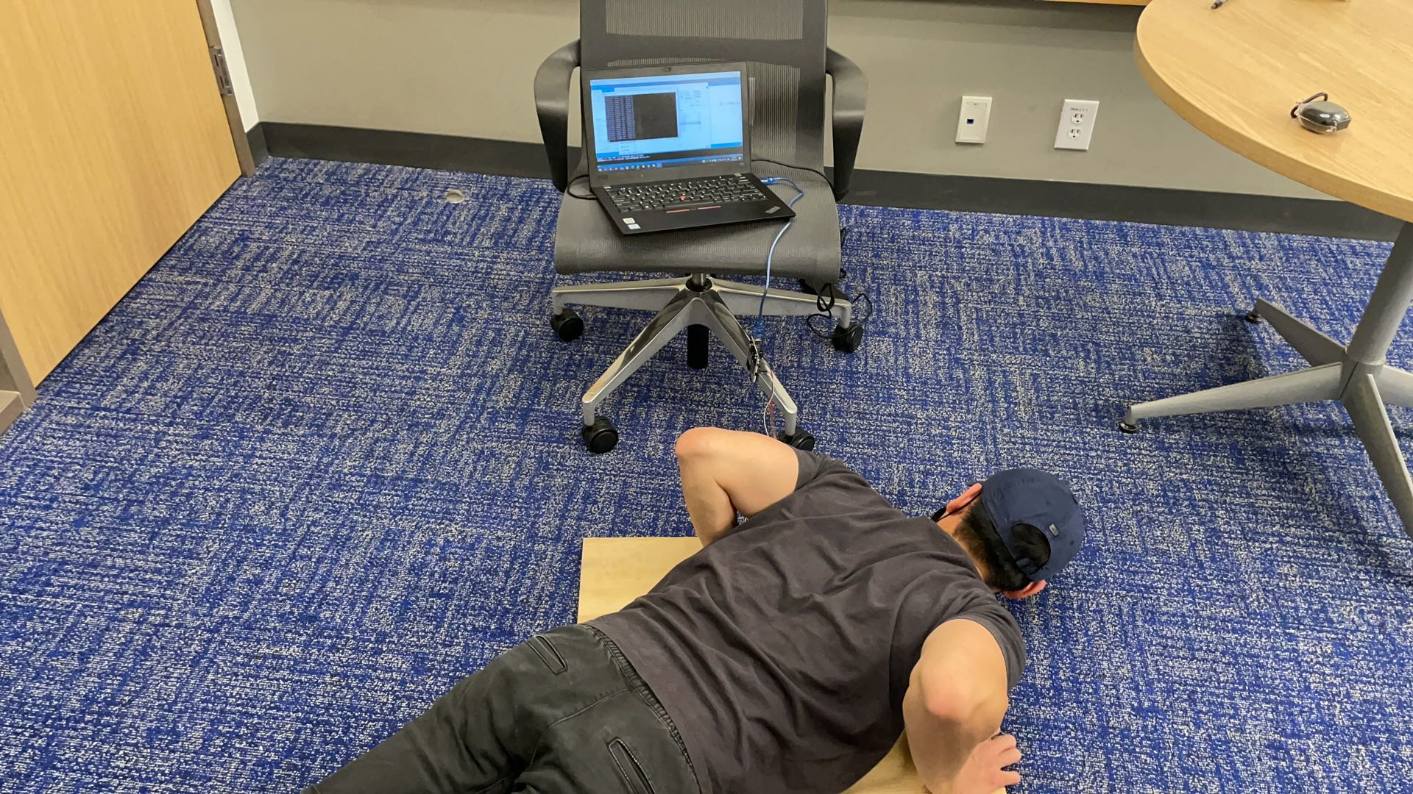
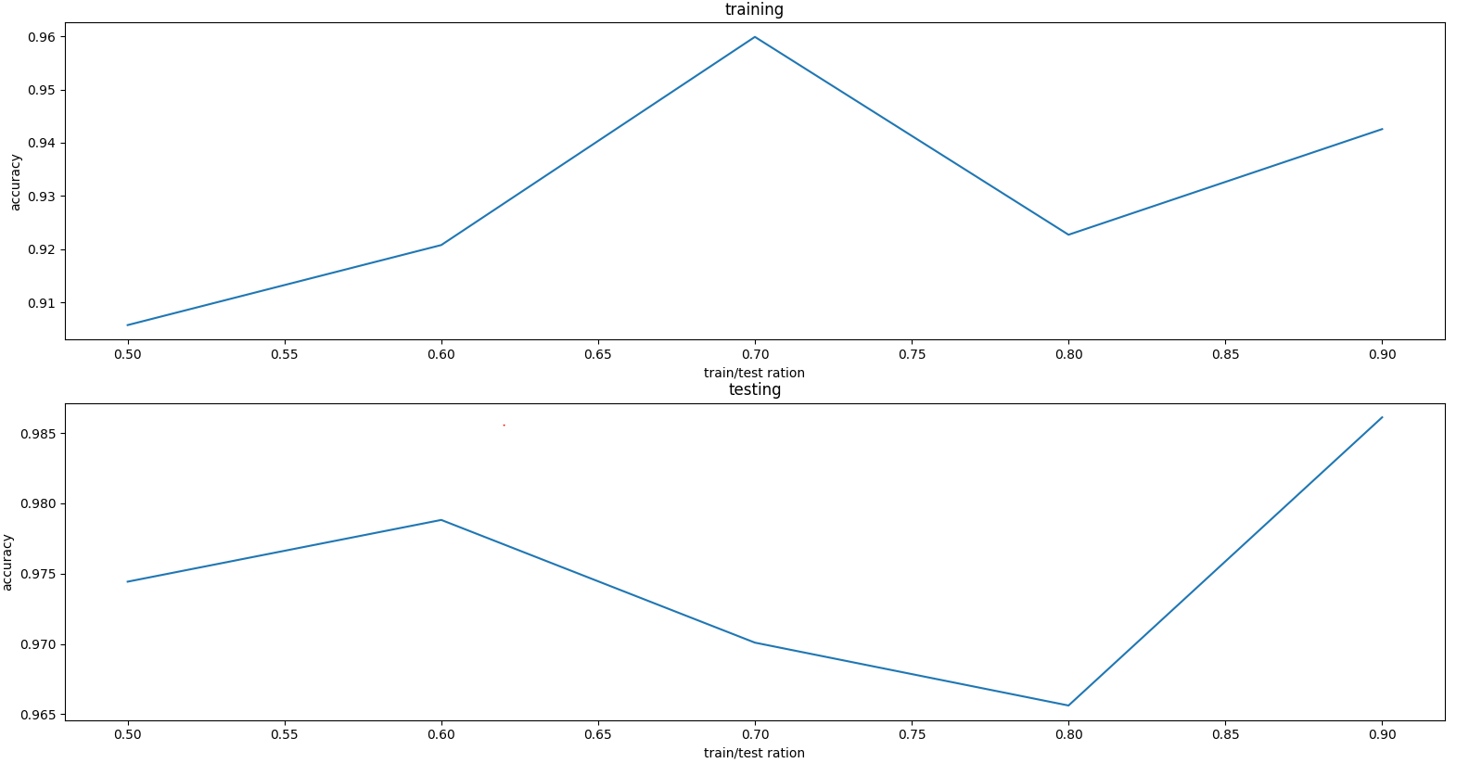
Evaluation
Machine Learning Algorithm Training and Testing
Data Statistics
Walking: 358
Jumping: 357
Stand/Sit: 258
Fall: 57
Experiments
Training / Testing Accuracy

Slide 11
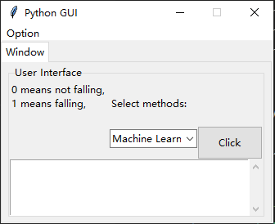
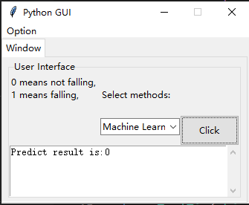
Evaluation
GUI
Testing example

Slide 12
Conclusion
It is feasible to use pressure sensors and MCU to implement a fall detection system.
Design the system properly and consider different conditions in advance.
Collect enough data for training the machine learning models.
Data preprocessing is more important than training the model.

